Slide 1


Analyzing CMIP6 data in Google Cloud
With thanks to Julius Busecke!
Tim Hermans, Python for lunch 22-01-2026

Slide 2
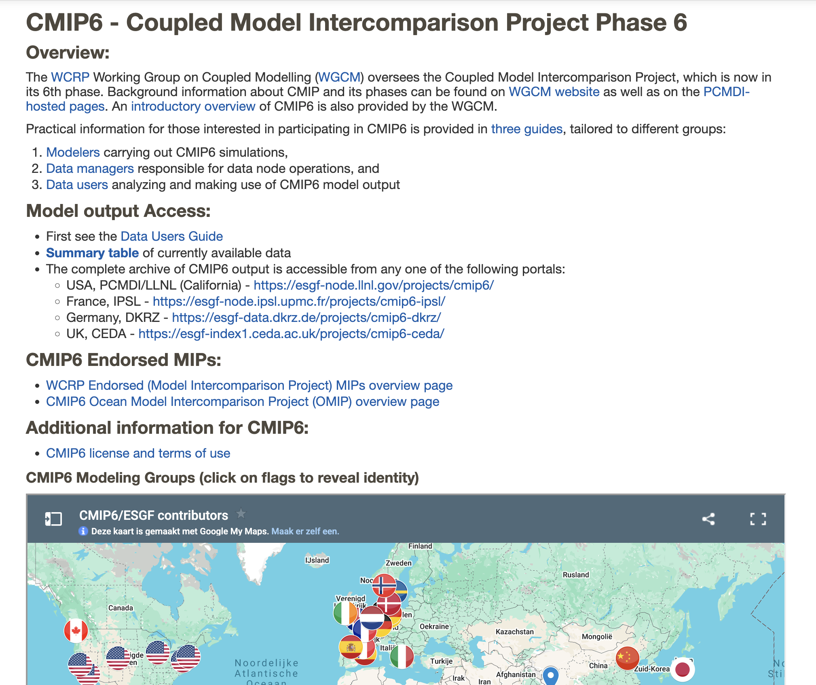
https://pcmdi.llnl.gov/CMIP6/

Slide 3
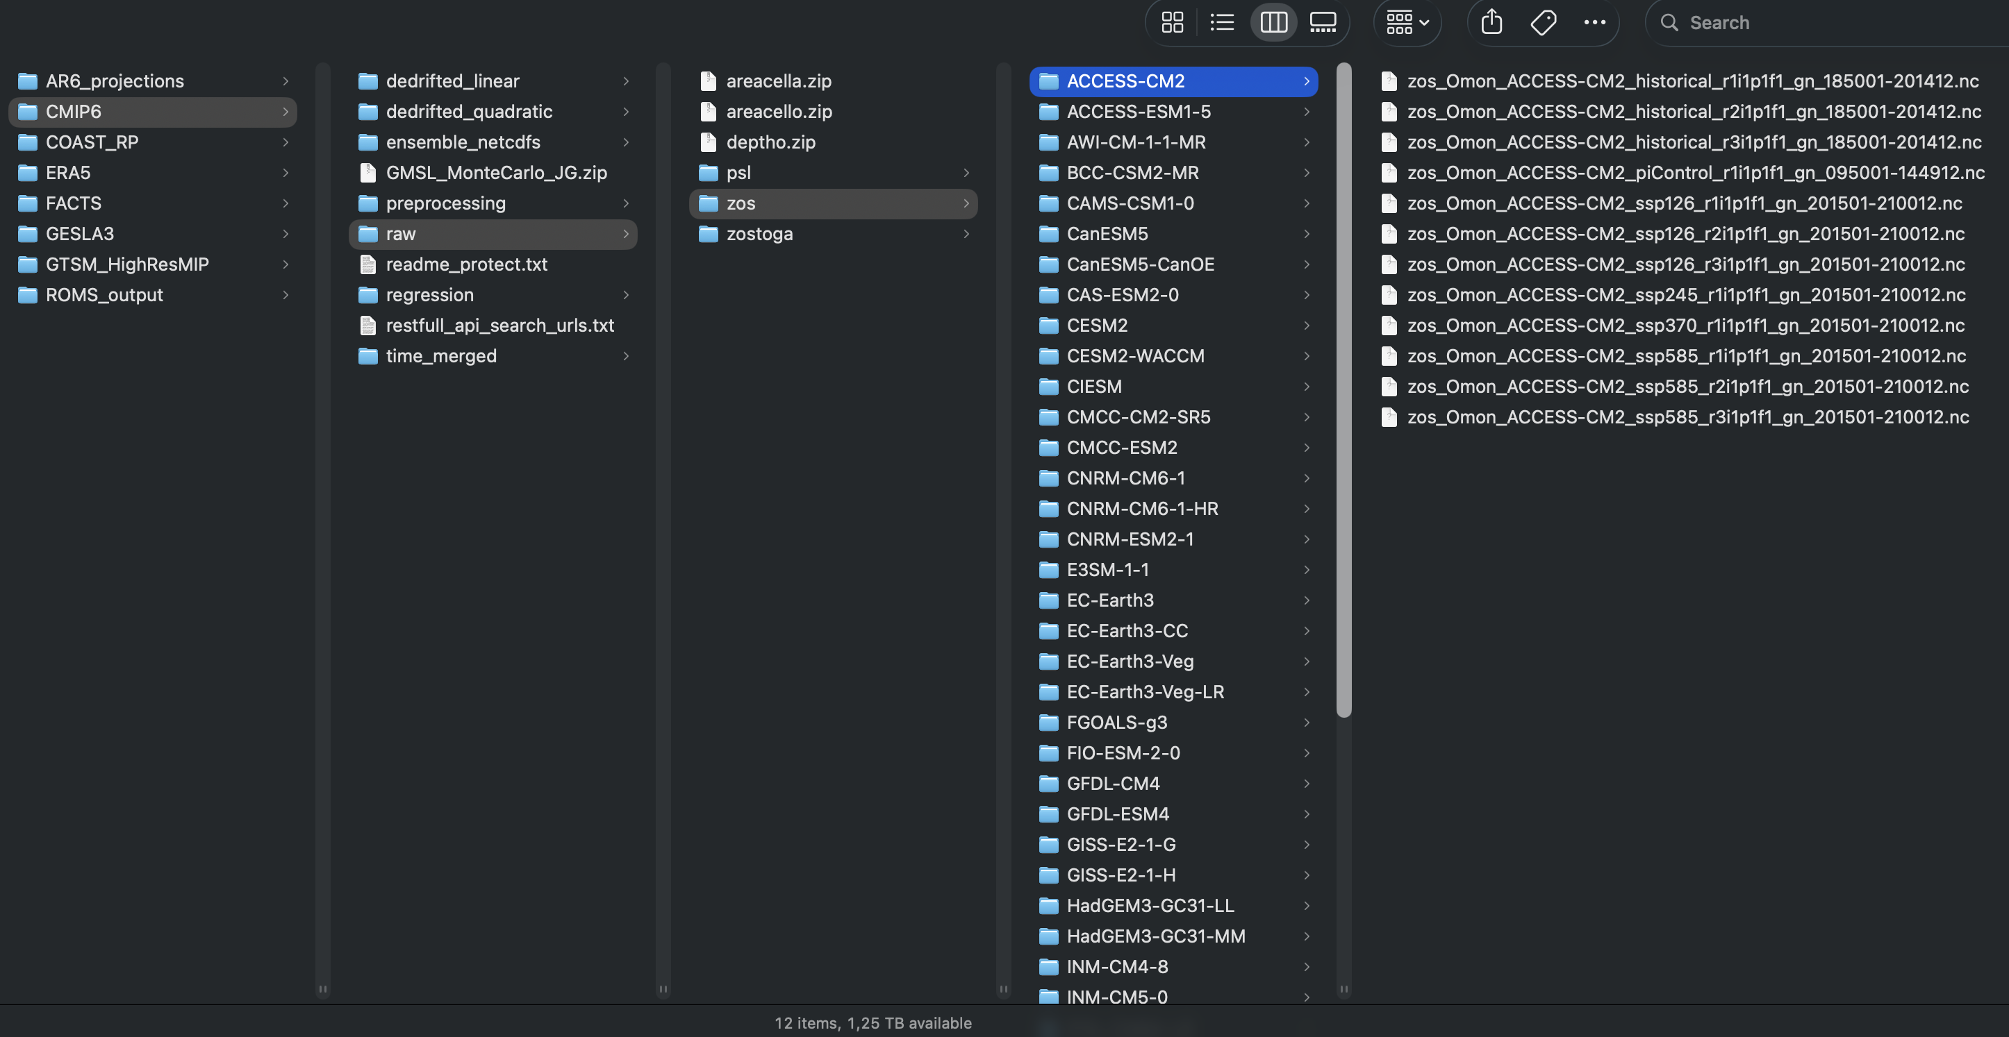
Typical workflow
Download locally or on HPC via https (OPeNDAP urls) or generate wget script (via search URL:
https://esgf-data.dkrz.de/esg-search/wget?query=CMIP6&variable=zos&frequency=mon&variant_label=r1i1p1f1&variant_label=r1i1p1f2&variant_label=r1i1p1f3&experiment_id=piControl&experiment_id=historical&experiment_id=ssp126&experiment_id=ssp245&experiment_id=ssp585&download_structure=variable,source_id&limit=10000
Analyze from there

Slide 4
Alternative: use cloud-based data
Google Public Datasets hosts CMIP6 data: https://cloud.google.com/blog/products/data-analytics/new-climate-model-data-now-google-public-datasets
Advantages:
No need to store data locally
Fast, & really fast if combined with data-proximate cloud-based compute
Less involved, more transparent, easier to reproduce
Scale up with dask (package for parallel, distributed computing)

Slide 5
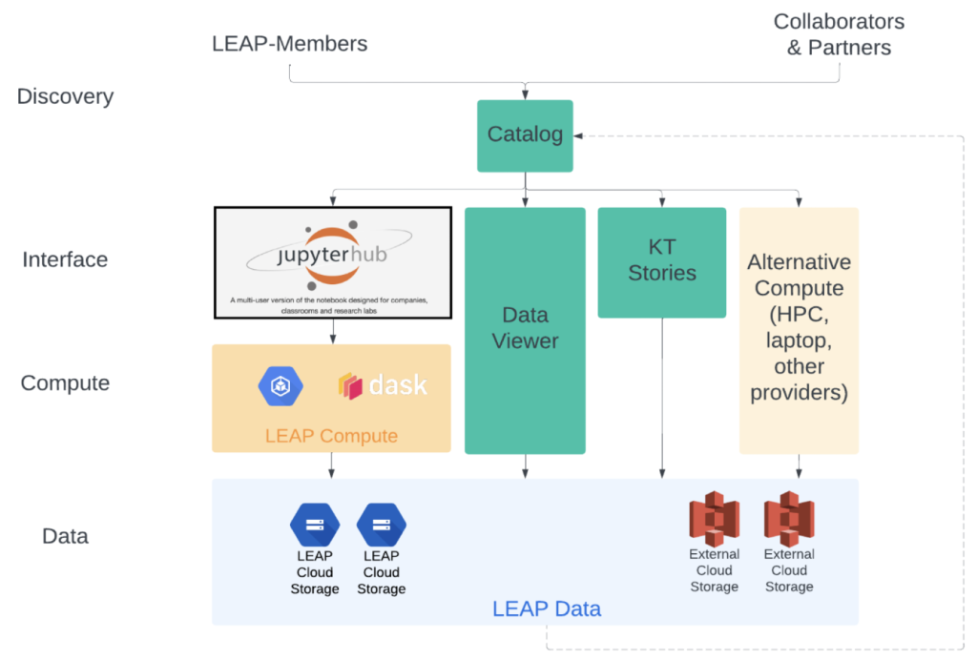

Slide 6
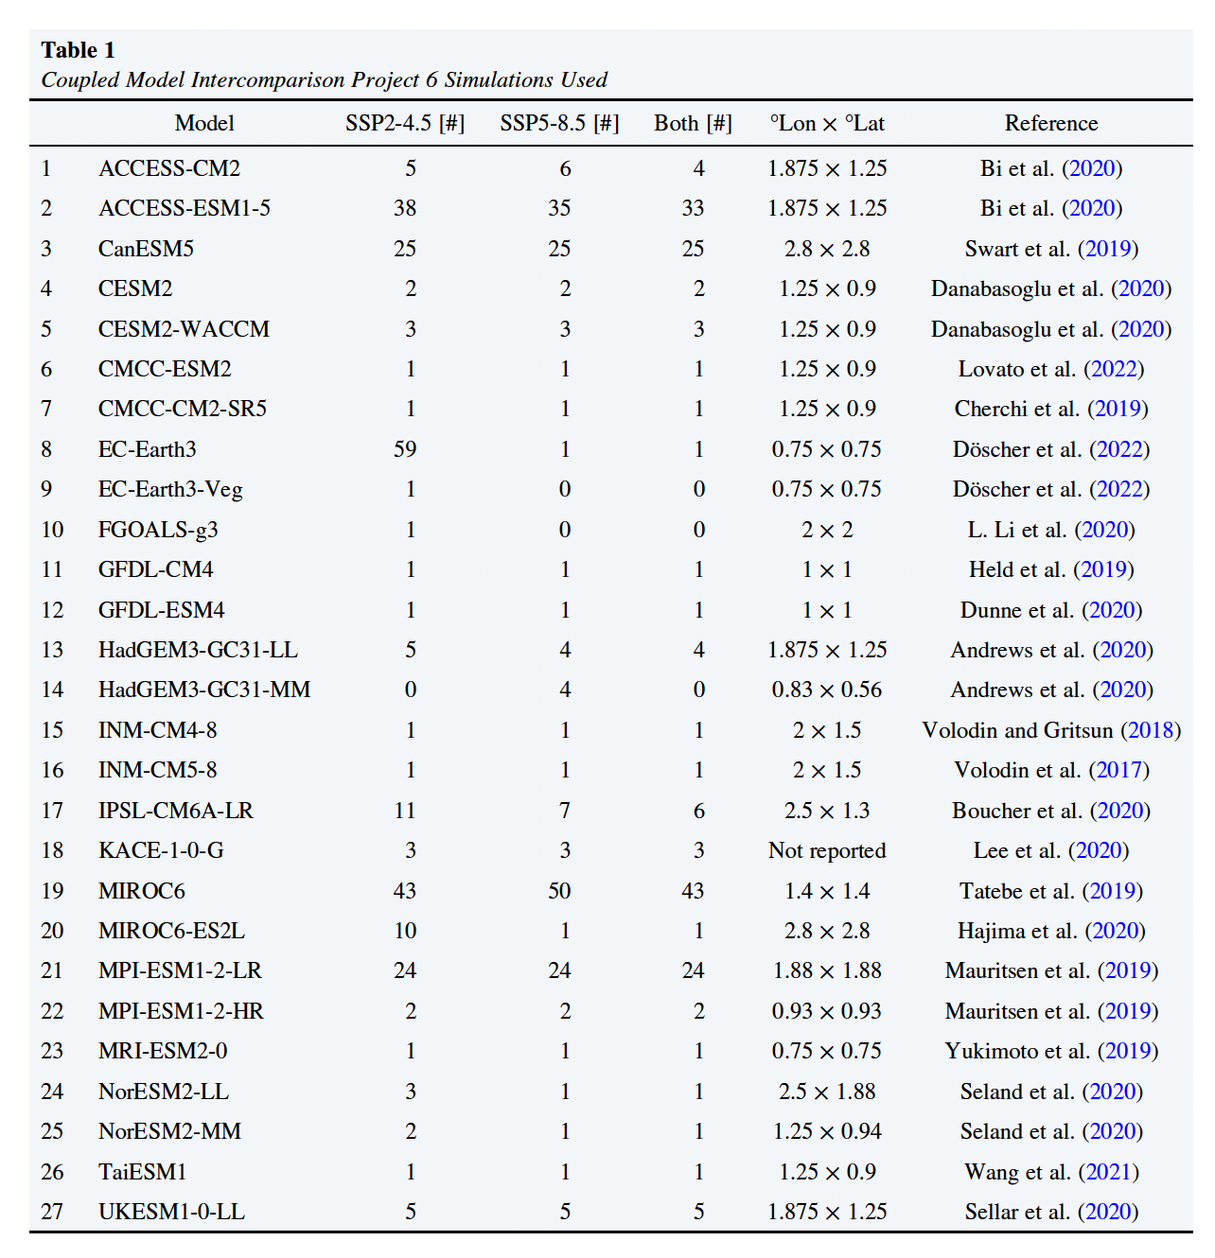
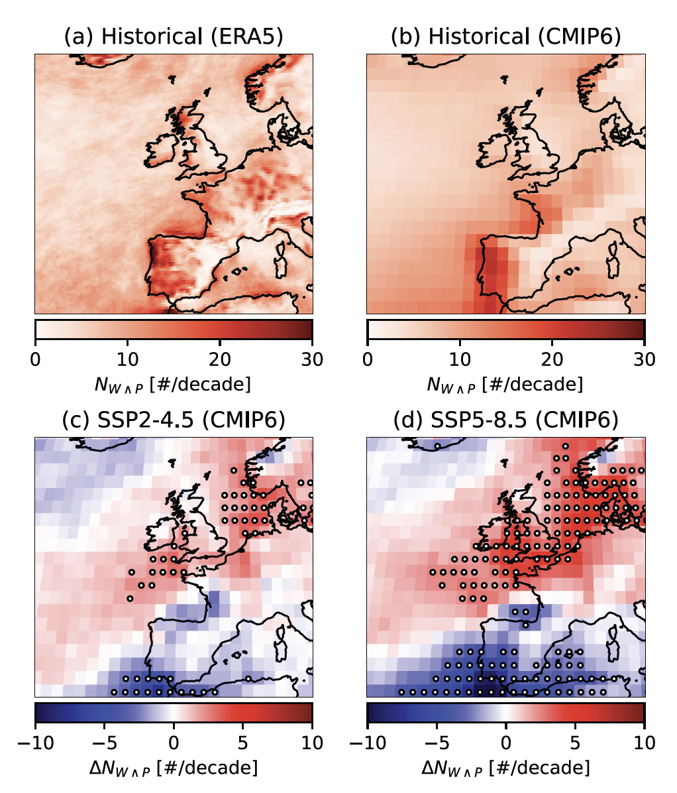
What can you do with this? #1
Analysis of daily precipitation, wind and sea-level pressure simulations (20 TB+ of CMIP6 data):
https://github.com/Timh37/CMIP6cex

Slide 7
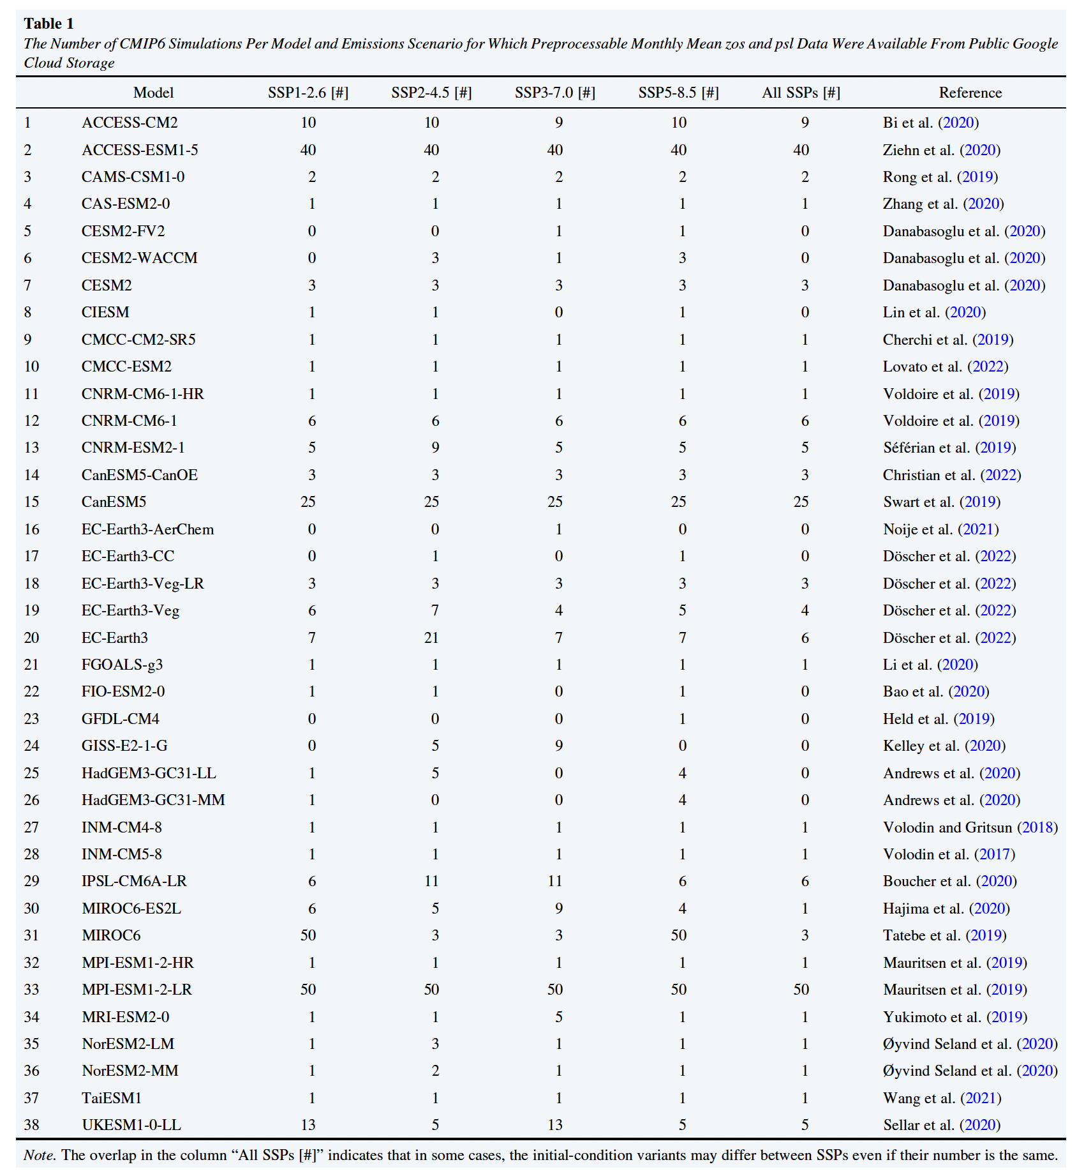
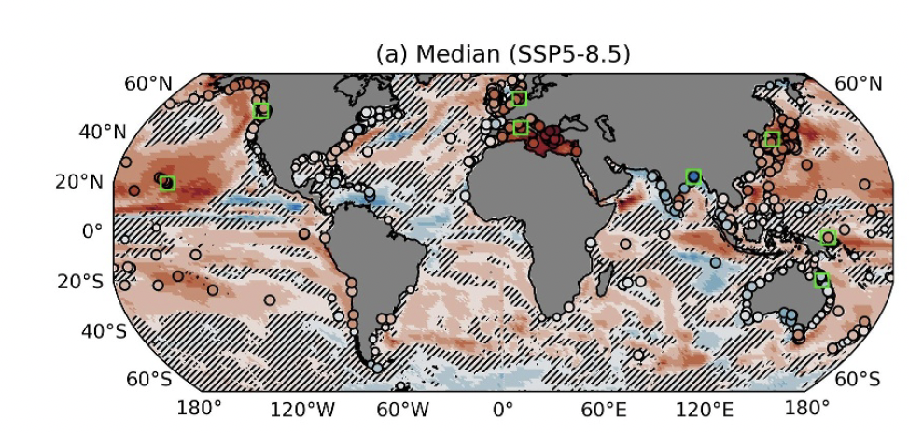
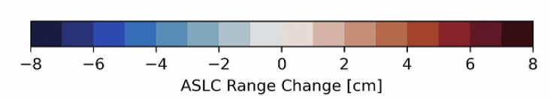
What can you do with this? #2
Analysis of monthly ocean dynamic sea level and sea-level pressure simulations
https://github.com/Timh37/aslc_cmip6

Slide 10
Demo notebook (inspired by pangeo gallery)
Clone github repository:
Create new environment:
conda create --name <ENV_NAME> --file <PATH>/gc_env.txt
Activate environment:
conda activate <ENV_NAME>
Open notebook: jupyter notebook

Slide 11
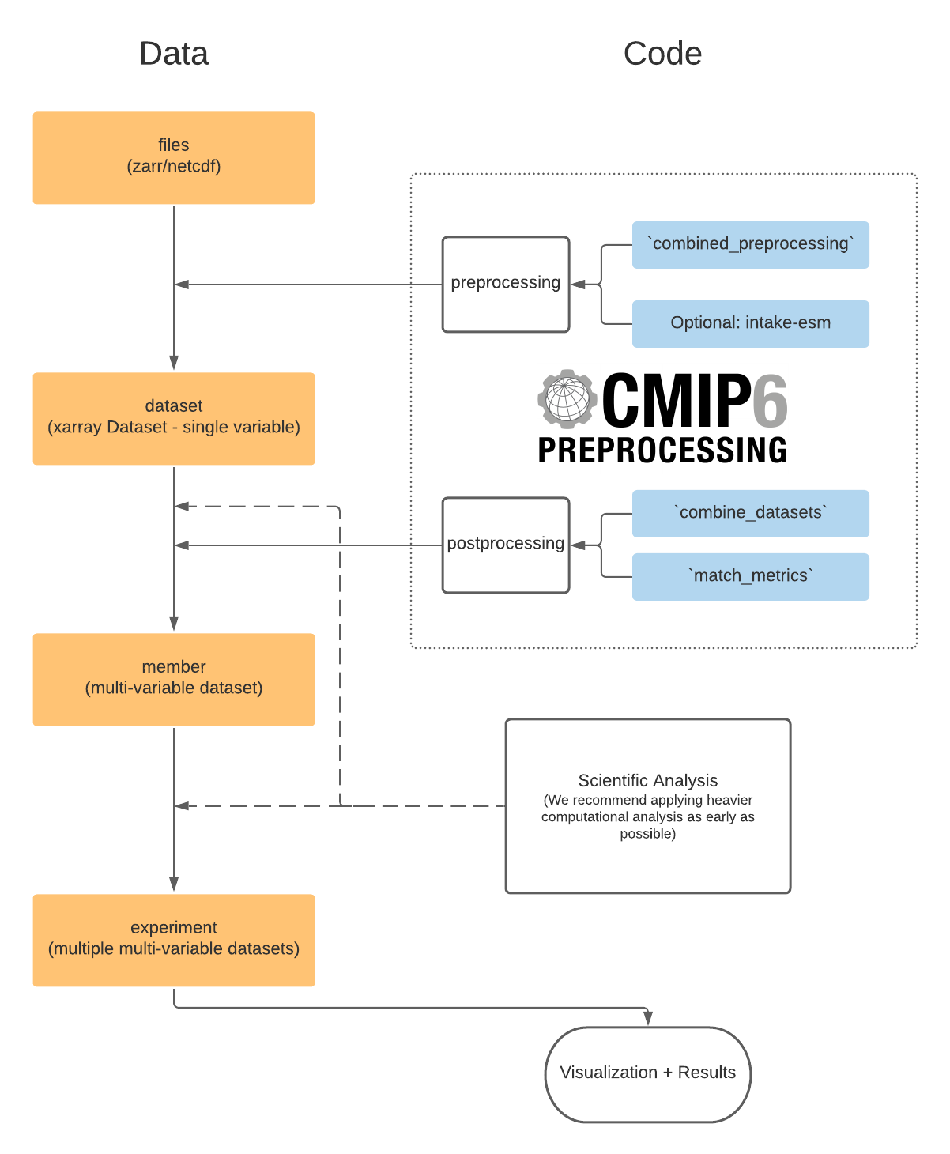


Slide 12
Getting started
https://cmip6-preprocessing.readthedocs.io/en/latest/?badge=latest
https://cmip6-preprocessing.readthedocs.io/en/latest/tutorial.html
https://gallery.pangeo.io/repos/pangeo-gallery/cmip6/
https://github.com/Timh37/aslc_cmip6/tree/main/preprocessing

